Slide 1
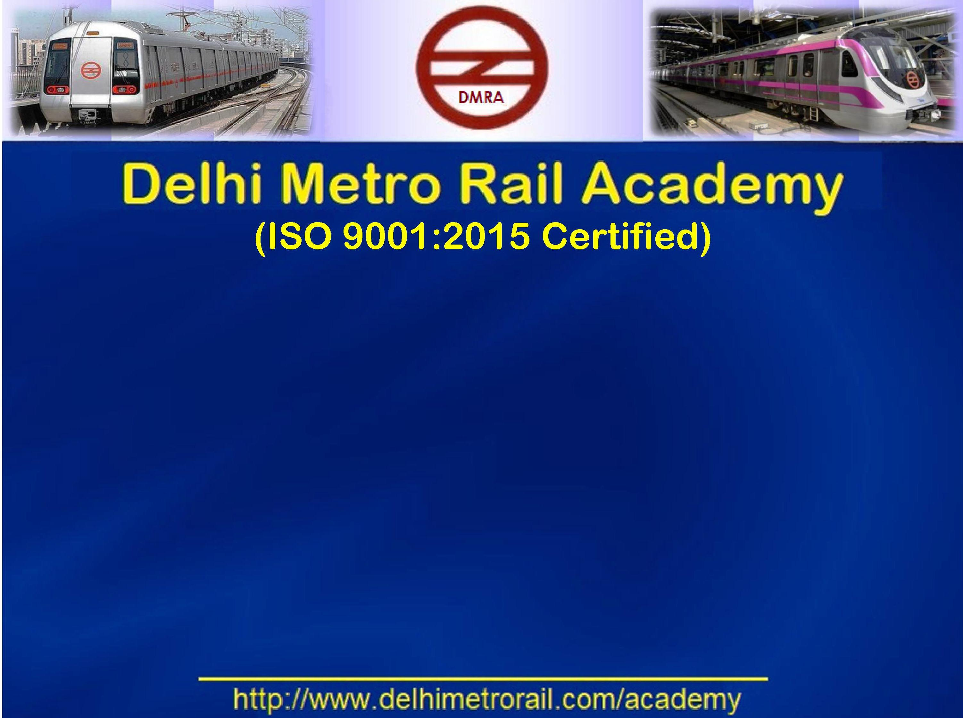
AFC Central System Interlinked with Stations

Slide 2
Introduction
Automatic Fare Collection System (AFCS) is meant for automated collection/computation of fare in electronic form and is based on contactless technology.
It automates the ticket selling, operation and accounting process.
AFC System Architecture:
AFC system is divided into Hierarchy of 5 different layers.
Layer 0: Media (CSC, CST)
Layer1: Equipment (TOM, Gate etc.)
Layer2:Station Computer (SC)
Layer3: Central Back office(CC)
Layer4:CCHS(Central Clearing Housing System)

Slide 3
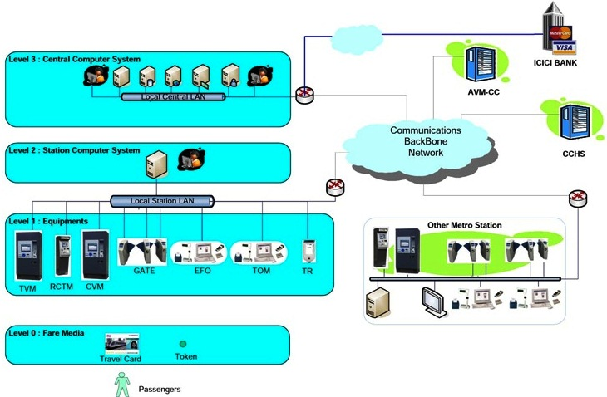
AFC Architecture Levels

Slide 5
Purpose of Central Computer:
Centralized communication with all AFC equipment for Data Collection, monitoring, supervision, troubleshooting and failure analysis of whole AFC system.
Centralized storage and processing of the transactions, cut-off and event data to efficiently performing back end activities of AFC central system like financial accounting, apportionment, reconciliation and processing outstanding liability of revenue collected by DMRC.
Configuration, Generation and uniform distribution the DMRC equipment operating data (EOD) which includes System parameters, Fare table, Agent list, blacklisting parameters to the AFC equipment via the SC.
To implement uniform security mechanism, equipment management to secure AFC system as well as AFC equipment.

Slide 6
To provide the necessary services and back end infrastructure to maintain digital payment, online recharging and ticketing facilities like add value through AVM, POS terminals and gate auto top up etc.
Centralized system management: Application software versions, time synchronization, abnormal working or behaviour of AFC system or AFC equipment, bug reporting and fixing etc.
Single point interface with other service providers for inter-compatibility and to track the utilization of the DMRC’s smart card as a common e-purse among multiple service provides.
Generation and analysis of revenue, ridership, and traffic related several reports for efficient traffic management & crowd management and smoothness of operation.

Slide 7
Functionality of AFC System:
Data Collection And Transaction Data Management
EOD \ Parameter Management
System Administration & Management
Database Administration & Management
Equipment Management
Network Administration & Management
System Security Management
Reports Management
Media Stock Management
DMRC Central System and other Service Provider Interface Management

Slide 8
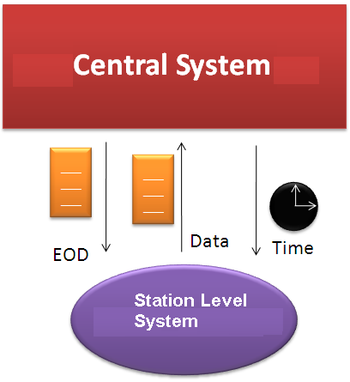

Slide 9
System Security Management
Security management is to Ensuring security of AFC System by using the cryptographic mechanism with security keys.
Security Keys are created and maintained at the Central system.
All equipment are provided with a security module which contains security related information.
Keys are being used for providing security, authentication by encryption and decryption.

Slide 10
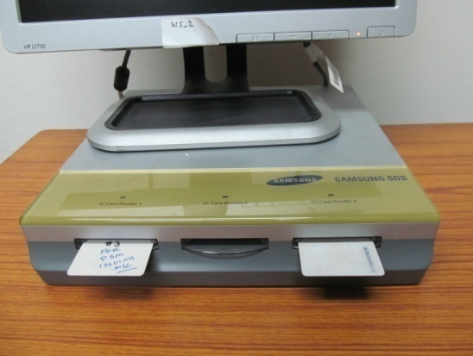
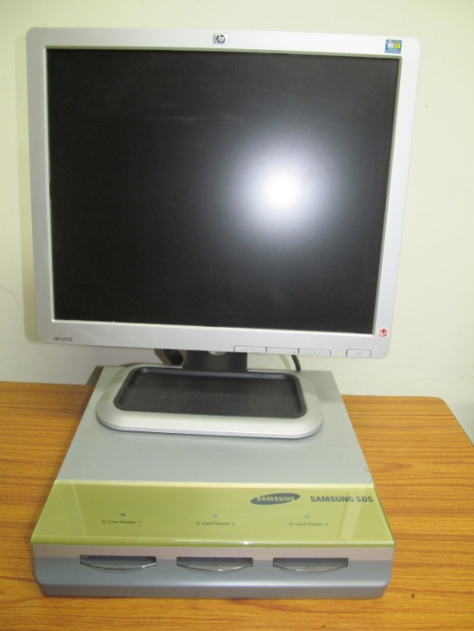
KIM (Key Initialization Machine)
DIM (DSM Issuing Machine)

Slide 11
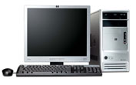
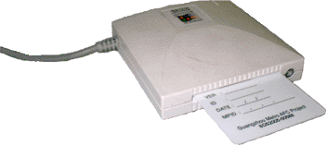
KIM (Key Initializing Machine) located and managed in a separate security area within CCHS, is an equipment to create and distribute all kinds of SAM used in all AFC system. The DSM is used to generate a Mutual Authentication Code (MAC) for the transaction to check that the transaction data has not been tampered with between the transaction getting generated and getting sent to the Transaction Summarisation service. DSM ID is used to uniquely identify a SAM/HSM. Device Security Module = SAM + Device Information.
KIM (Key Initializating Machine
KIM

Slide 12
MIS Reports Management
Report is generated by using Business Object tool which can generates reports on daily, weekly or monthly basis.
Reports can be accessed through Web Browsers and CC GUI.
Aggregated data of Central Computer is used for report generation.
Business Object Programs get executed at scheduled time and generate required reports.
Other report querying and analysis is done by system analyst by accessing the central computer database through database query.
Various Types of Reports are:
Ticket transaction reports
Revenue reports
Traffic reports
Stock reports
Maintenance reports etc.

Slide 13
CCHS
The Central Clearing House System is proposed as solution for integrating of DMRC Phase I, Phase II, subsequent phases of AFC Systems and also provide a standard framework for integrating with the future service providers such as other public transport (city Bus Transport services), parking service, toll services, retail, Banks and other financial business partners to implement the existing DMRC smart card as common e-purse for the common ticketing among various service providers system.
Present Integrations:
RMGL.
DTC / DIMTS Buses.
DMRC Parking.
Feeder Buses.
HHT for penalty.

Slide 14
URC Management
Unreadable cards are submitted at stations with details filled in URC foils.
New smart card is issued to passenger immediately.
SC/SM makes online entry of URC details in AFC Portal on daily basis.
URC remaining value is resolved within 5 days and uploaded at AVM DB as top-up against the respective new smart card issued.
All submitted URCs are physically submitted to AFC/OCC periodically.
The URC Top-up transaction is cancelled after 90 days and amount is forfeited as per Business Rule..

Slide 15
Auto Top Up System:
Done on ICICI, Indusind Bank and Autope Cards.
Through CCHS TDI server.
Combo cards validated through Bank Mandate process.
All Gates and Toms applications modified to detect auto top-up flag on Sv5 product cards.
Cards gets auto add value of Rs. 200/-(Top-up amount) through gates when the balance goes below Rs. 100/- (Threshold amount).
Auto top-up happens from entry gate only.
Debit request file created at CCHS and send to bank.
Amount transfer from bank to DMRC account on T+1 day basis.

Slide 16
Central-Station Coordination:
Central and station coordination is essentially required for smooth functioning of AFC system.
Ensure Network connectivity.
Ensure correct application version in all AFC equipment.
Ensure correct EOD version in all AFC equipment.
Ensure proper time synchronization in all AFC Equipment.
Ensure correct procedure during replacement of equipment (Tom, Gate) during failure.

Slide 17

Thank You
for
Giving me an opportunity
for sharing my views

